Slide 1
Vine Pruning for Efficient Multi-Pass Dependency Parsing
Wang Yizhong
Notes:
Good afternoon, everyone! The topic I’m going to deliver today is about vine pruning. As we know, pruning is a basic method to reduce search space. When we find some branches of the search tree is impossible, we cut it off and don’t explore it. Although the idea is well-known and simple, the author uses it to propose a novel framework for dependency parsing and it works pretty well. I really appreciate this artful adaptation of pruning and this coarse-to-fine method is similar to our work, so I chose this paper to talk about.

Slide 2
Contents
Background of Dependency Parsing
Motivation
Detailed Algorithm
Results and Comparison
Notes:
In today’s talk, I will mainly cover these four sections. First, I will give some background knowledge of dependency parsing and high-order parsing. Next, I’d like to introduce the motivation of this work, that is why the author came up with this idea. Then I’ll show the detailed algorithm of Vine pruning and the whole framework. In the end, I will compare this work with previous parsing algorithms. Now, let’s start.

Slide 3
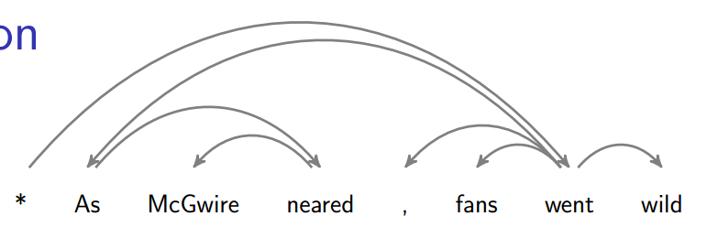
Dependency parsing
Input: A sentence
Output: A parse tree
n edges
Root
Modifier
Head
Notes:
First, what is dependency parsing? Suppose we are given a sentence, a dependency parser can generate a parse tree which reflects the dependency relation between each pair of words. For example, we have a sentence “as McGwire neared, fans went wild”. Fans is the subject of went here, so we say fans is dependent on went. And we call fans modifier and went is the head. We can use an arc from head to modifier to represent this dependency relation. Moreover, we add a star to the left of the sentence. This star must be the root of the final parse tree. So totally there are n edges in this dependency parse tree. Our job is to get a parse tree from a sentence.

Slide 4
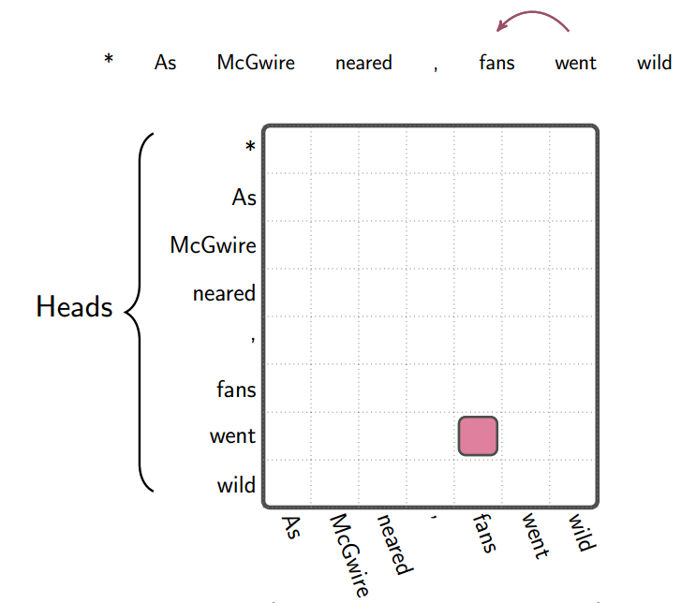
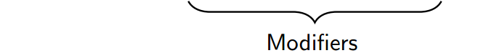


Representation
$$n\left(n+1\right)$$
$$n$$
Notes:
For later convenience, here I introduce a new representation of the parse tree. We can use this table. The x axis is modifiers and y axis is heads.
An arc between a pair of words can be denoted as a cell in this table. For example, this pink cell represents a possible arc from went to fans. We can see there are totally n times n plus 1 possible arcs. And we should choose n arcs from them to construct a tree.

Slide 5
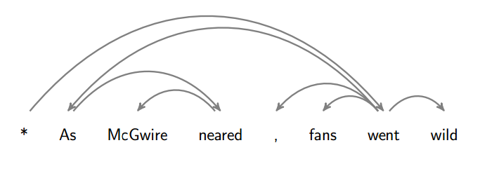
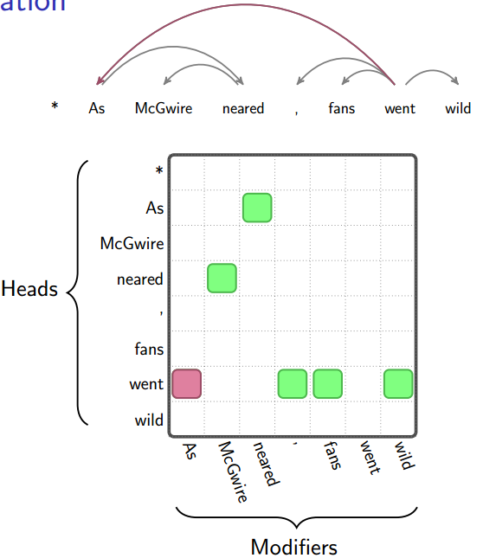
Representation
Notes:
The final parse tree will look like this. This tree can be represented in the table with green cells. Every word has one head and the star is the root of the parse tree.

Slide 6
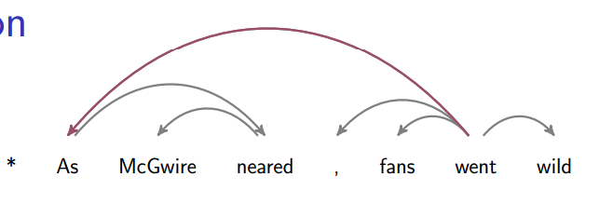



First order VS High order
Index set: All possible arcs
First order: $I_{1}=\left\{\left(h,m\right) \right| hε\left[0,n\right],mε\left[1,n\right]\}$
High order: $I_{k,l}=\left\{\left(a,s\right) \right| aε{\left[0,n\right]}^{k+1},sε{\left[1,n\right]}^{l+1}\}$
$$O(n^{2})$$
$$O(n^{2+k+l})$$
Notes:
Next, I’d like to explain the meaning of first order and high order. First order means when you extract the features of an arc, you just consider these two words independently, while high order consider other words relevant to this two words. For example, if you consider the arc from went to as, you can also take the arc from went to comma or fans into consideration. Here as, fans, went are siblings. Also, if you consider the arc from neared to McGwire, you can also consider the arc from as to neared. Because as is the grandparent of McGwire.
Of course, for different order, the complexity is different. I introduce a concept of index set here. It represents all possible arcs in parsing and we can construct our parse tree from this set. The size of index set is different for different orders. For first order, the complexity is n to the power of 2. For high order, it’s n to the power of 2 plus k plus l. K is how many generations of ancestors you consider and l is the number of siblings.

Slide 7
Dilemma
High order?
More features
High accuracy
Complex
Slow
Notes:
So we encounter a dilemma that with high order, we can extract more features and improve the accuracy but it is very complex in time and runs slowly. We have to think up a solution to reduce complexity.

Slide 8
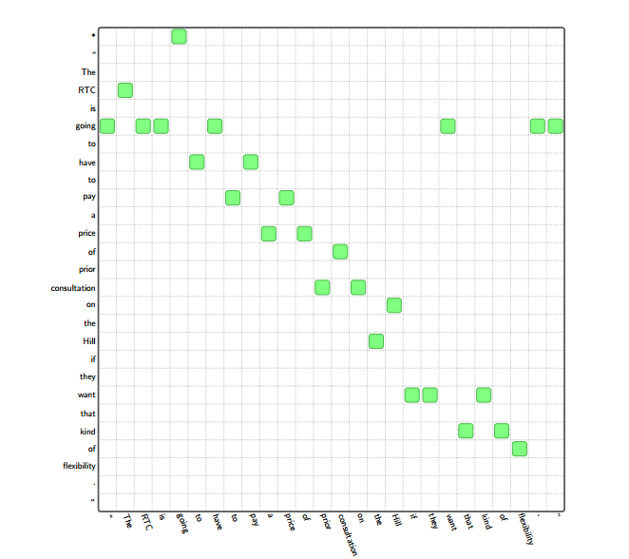
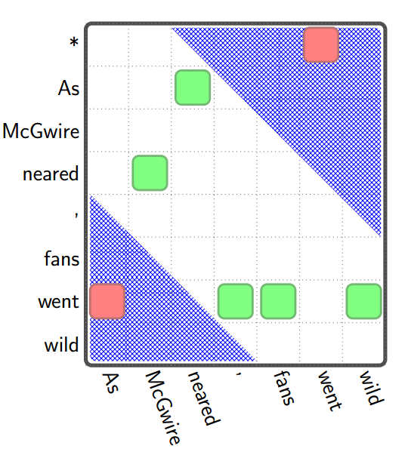
Motivation
Notes:
Reconsider this sentence, we may find that the colored cells are mostly distributed in the neighbor of main diagonal. This is especially obvious when the sentence length is long enough. Look at this long sentence, most of the green cells are along the main diagonal.

Slide 9
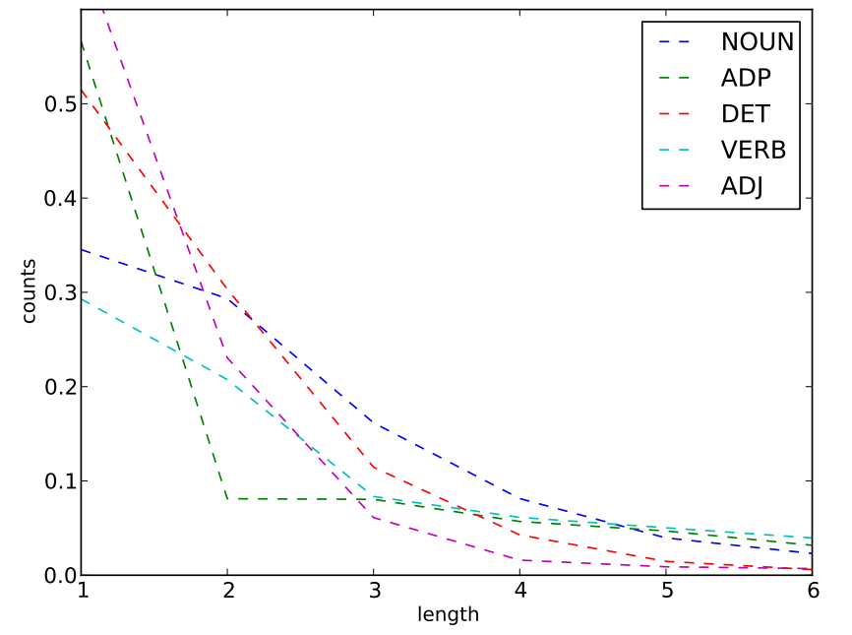
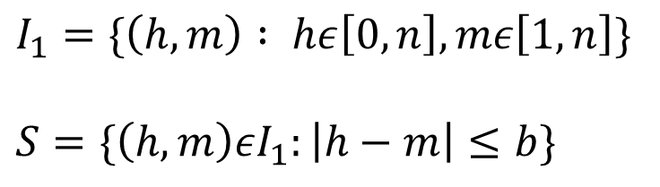
Arc Length for Modifier POS-tags
$$I_{1}=\{\left(h,m\right) : hε\left[0,n\right],mε\left[1,n\right]\}$$
$$S=\{\left(h,m\right)εI_{1}:\left|h−m\right|≤b\}$$
Notes:
The reason for this phenomenon is simple. This pictures shows the distribution of arc length for common modifier pos tags. We can see the arc length in the final parse tree is mostly shorter than 4. So we can prune the index set by limiting the length of arcs within b. I1 is the previous index set and S is the new index set.

Slide 10
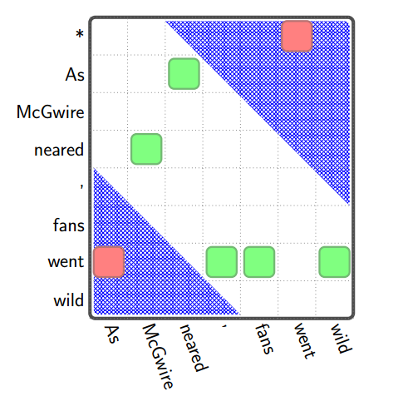
Another Problem
Notes:
There is still another problem. If all the index is limited within b, these two pink cells will be missed. So we should consider this circumstance in our index set and don’t prune it. The solution is to add outer arcs.

Slide 11
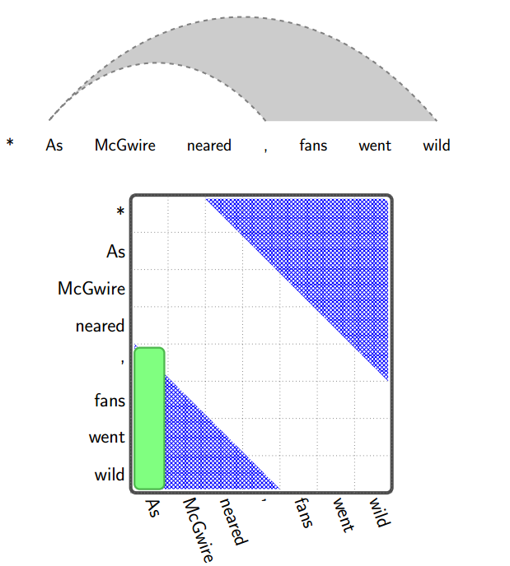
Outer Arcs
Notes:
Consider the arc from went to as. For as, it can not find a suitable head within the range of b, so it creates an out arc to accepts other possible words beyond b as its head. We use this green column to denote all these words can be the head of as.

Slide 12
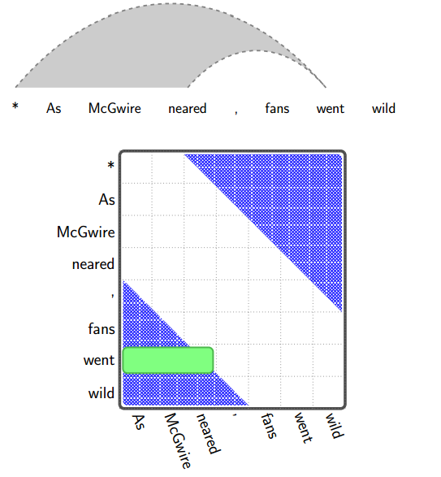
Outer Arcs
Notes:
On the contrary, for went, it can not find a suitable modifier within range of b. So it creates another kind of out arc to accept other possible words beyond b as its modifier. We use this green row to denote that these words can be the modifier of went.

Slide 13
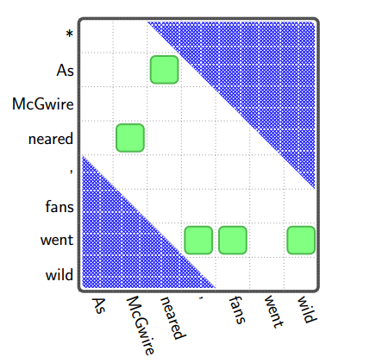
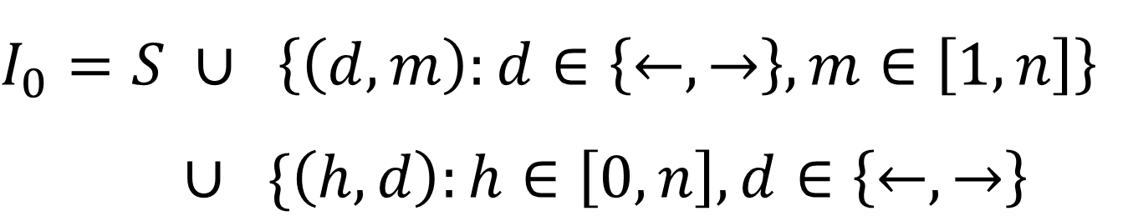
New Index Set
$$I_{0}=S ∪ \left\{\left(d,m\right):d∈\left\{←,→\right\},m∈\left[1,n\right]\right\}$$
$∪$ $\{\left(h,d\right):h∈\left[0,n\right],d∈\left\{←,→\right\}$
S : The index set within length limit b
d : direction
m : index m can be a modifier
h : index h can be a head
Notes:
So we augment the index set as this. S is the previous index set within length limit b. Besides this, for every word, we add the possibilities that it can be a modifier and modify words in two directions and possibilities that a word can be a head and dominate other words from two directions. We can represent these three subset as three different parts in the table. Actually, this index set is the search space of vine pruning. Now let’s come to how to construct a parse tree from this index set.

Slide 14
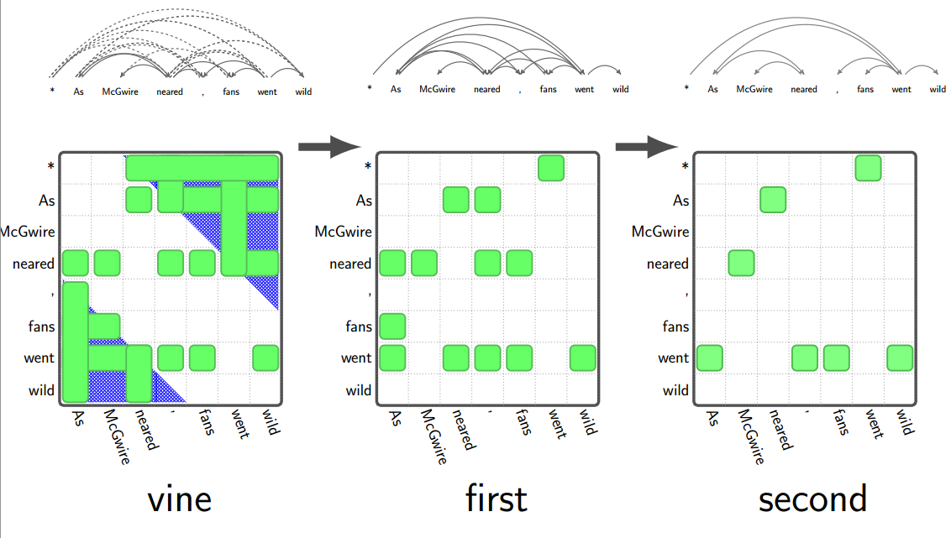
Overview of Parsing : Vine Cascade
Notes:
First let me give an overview of parsing. Now we have the index set, we first use vine pruning to prune some impossible arcs and leave these green ones. Then we use first order rules to further prune the outer arcs. At last, in order to guarantee we can get a tree, a traditional second order parser is employed but of course the index set is much smaller. Actually we can also use only vine to prune or first order rule to prune. I’ll later compare the results of them. Here this three-pass parsing algorithm is somewhat like a cascade, so the author use vine cascade to describe this parsing algorithm. The detailed pruning and parsing uses dynamic programming. It’s a little hard to follow and I hope you can understand it.

Slide 15
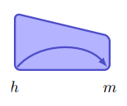
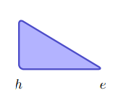
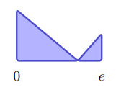
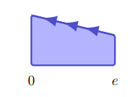
Vine Pruning Rules
m modifies h
Four Symbols:
A complete subtree from h to e
e has not taken a close (within b) head to its left
e has not taken a close (within b) head to its right
Notes:
First, let me introduce four symbols here. This trapezoid with an arc in it means m modifies h. It is just a single arc.
This triangle means a complete subtree. H is the root of this subtree and all words in this span have found heads. Their heads are also in this span.
This combination of two triangles means e has not taken a close head within b to its left, while this trapezoid with three arrows means e has not taken a close head within b to its right.

Slide 16
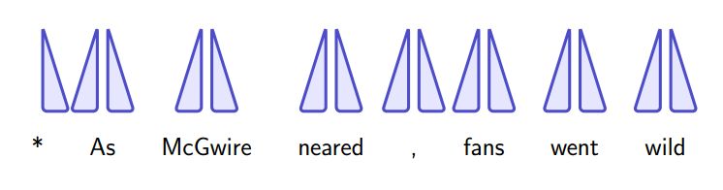
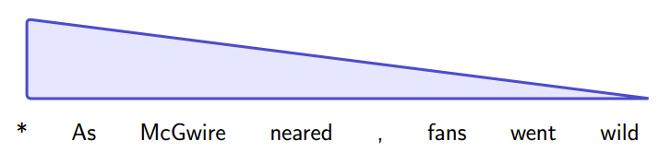
Vine Pruning Rules
Initial state:
DP inference
Final state:
Notes:
Now we have the symbol we can show the process of parsing. Actually it’s a dynamic programming inference. Initially, we denote every word as two back-to-back triangles. This is just a notation. In the end, we get a big triangle. This means star is the root and all words in this sentence have found heads. So how to infer from the initial state to the final state?

Slide 17
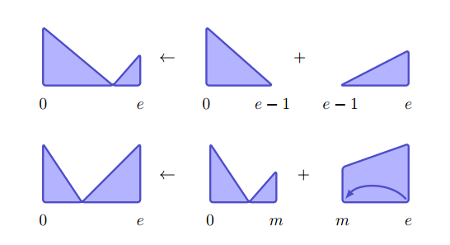
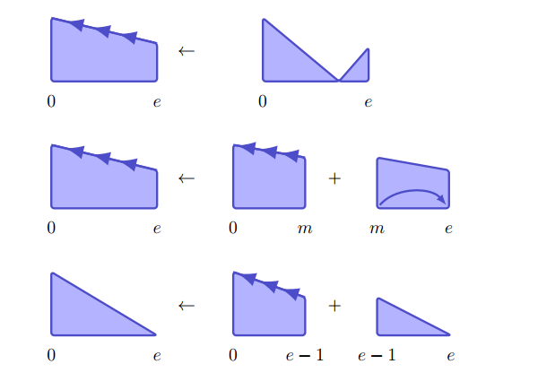
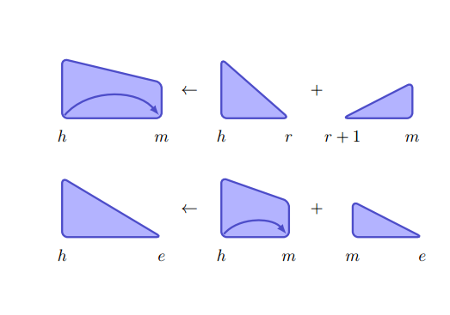
Vine Pruning Rules
Beyond range b
Within range b
Notes:
We have seven rules for inference. These two are for the index set within range b. And the other five is for outer arcs. This is a little unclear and puzzling. So I use an example here to show how vine parsing prune index set.

Slide 18
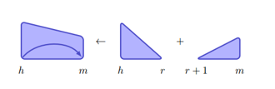
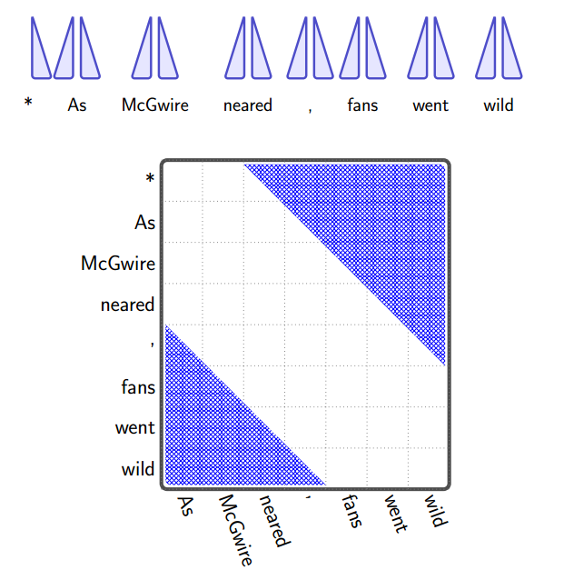
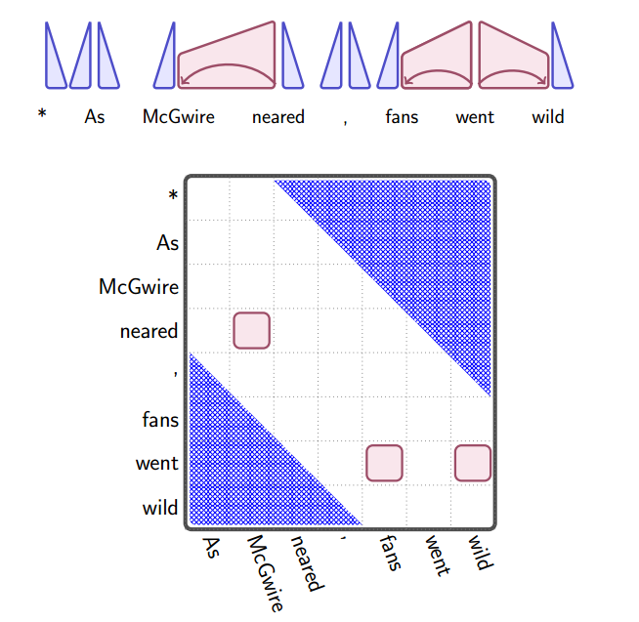
Notes:
The initial state is like this. And then we scan all possible arcs with length less than b and find these three arcs are confident. So for this notation, we can combine these two triangles with this rule.

Slide 19

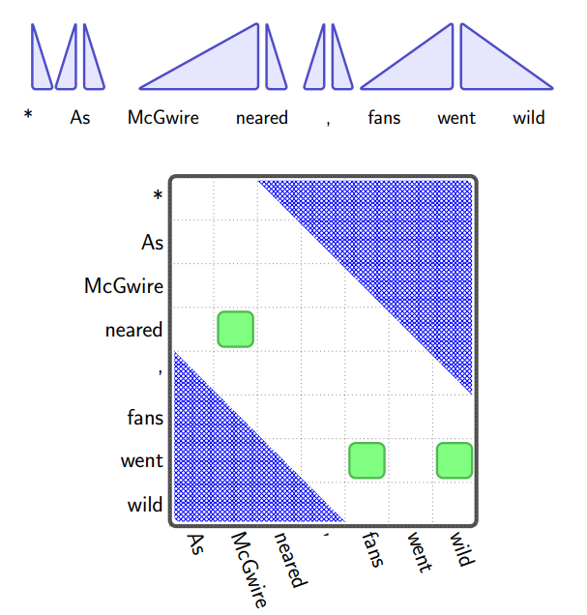
Notes:
Then using this rule, this triangle and trapezoid can be combined to be a larger triangle

Slide 20
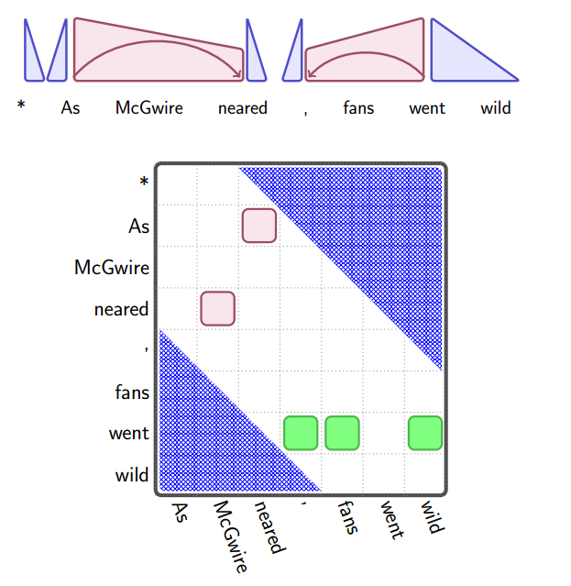
Notes:
Next, we apply this rule to create this trapezoid. These reference are all within the length limit b.

Slide 21
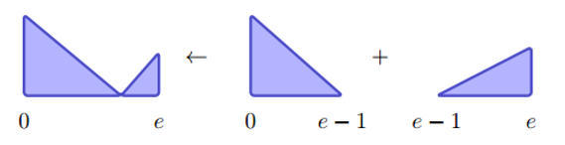

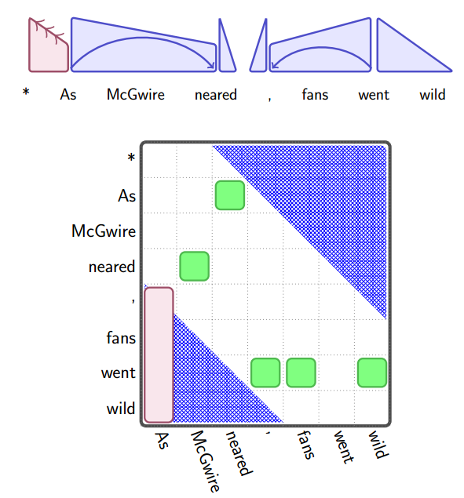
Notes:
Next, we consider outer arcs. This two rules can combine these two triangles and create this trapezoid. This indicates word as hasn’t taken close head to its right. So this pink column indicates all these four words may possibly be the head of as.

Slide 22
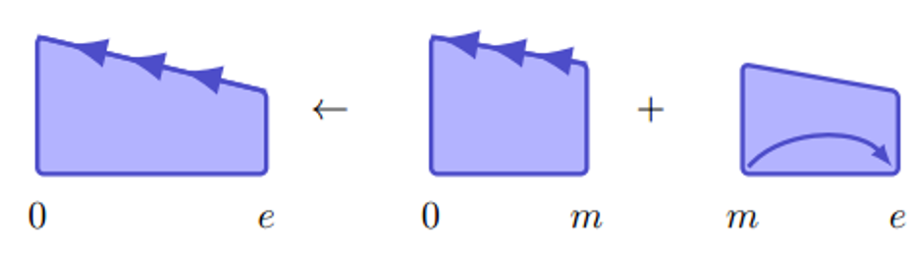
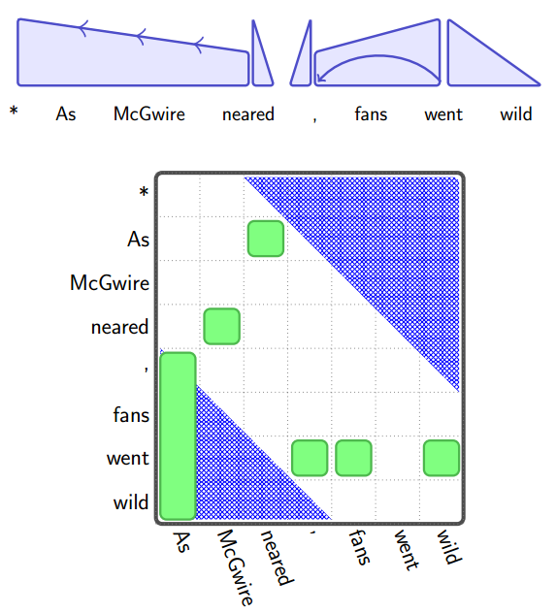
Notes:
Next, this rule can be applied to combine two trapezoid. Similar application of rules can be used to infer a parse tree. Because time is limited, I will go through them quickly.

Slide 23
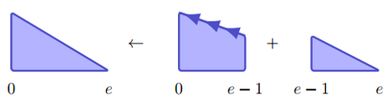
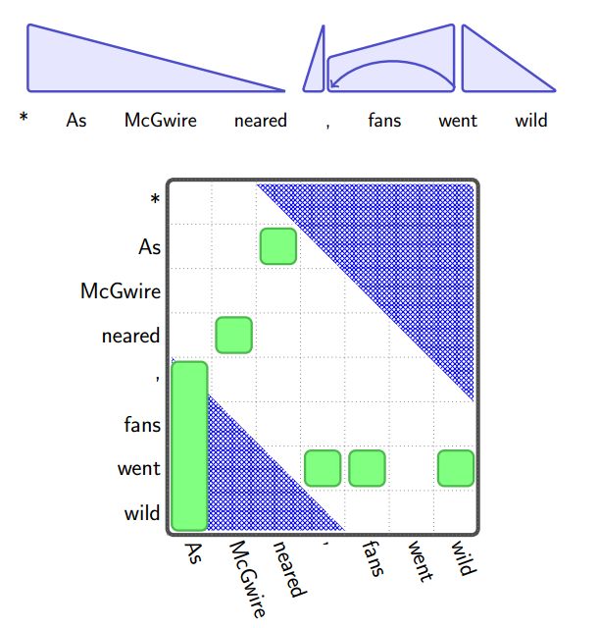

Slide 24
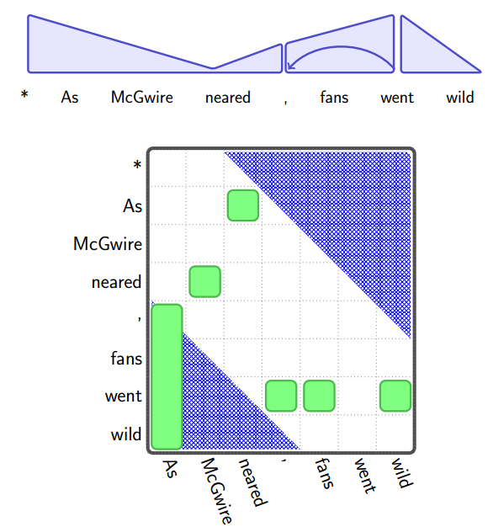

Slide 25

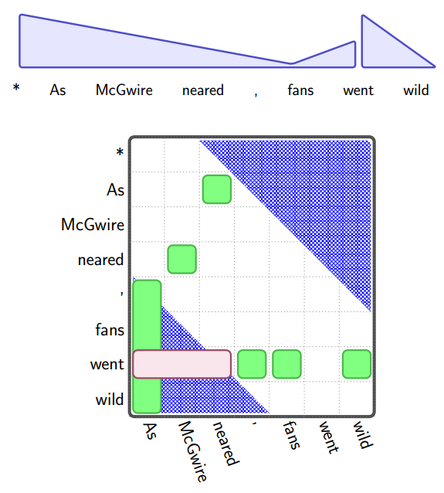

Slide 26
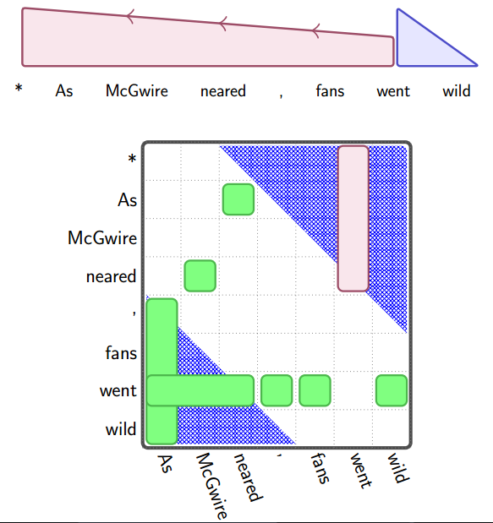
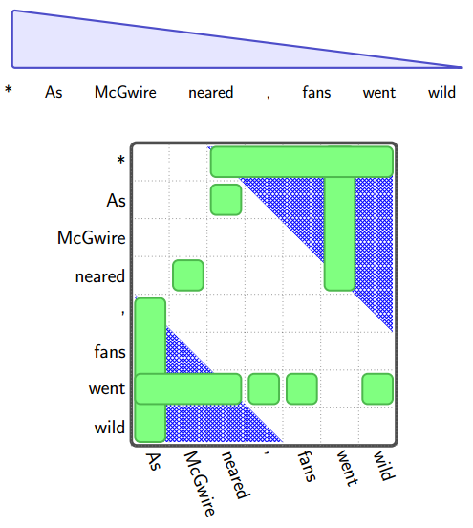
Notes:
Finally, we use this two rules to construct this final complete triangle. Now vine pruning is over. We can see from this table that possible arcs reduces significantly. These green cells are possible arcs. First order pruning and second order parsing can then be used to construct the final parse tree. Because it is not the work of this paper, so I don’t give further details.

Slide 27
Results and Comparison
Notes:
Finally, let’s see the results of this algorithm.

Slide 28
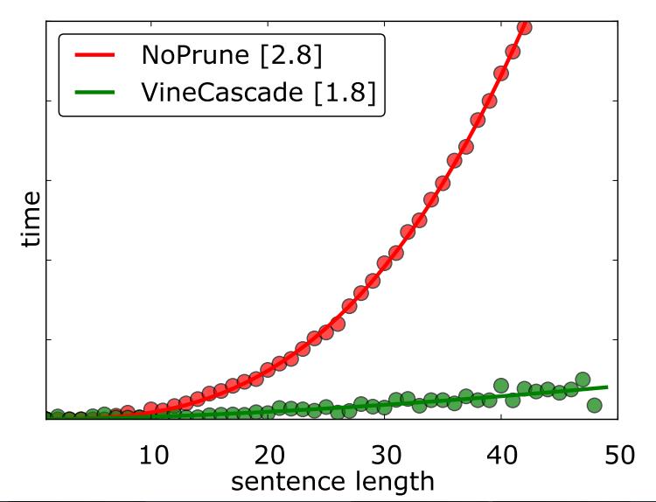
Empirical Complexity
Notes:
According to the author, this vine parsing algorithm obtains a significant decrease in empirical complexity. The complexity magnitude drops from 2.8 to 1.8. It’s a big progress.

Slide 29
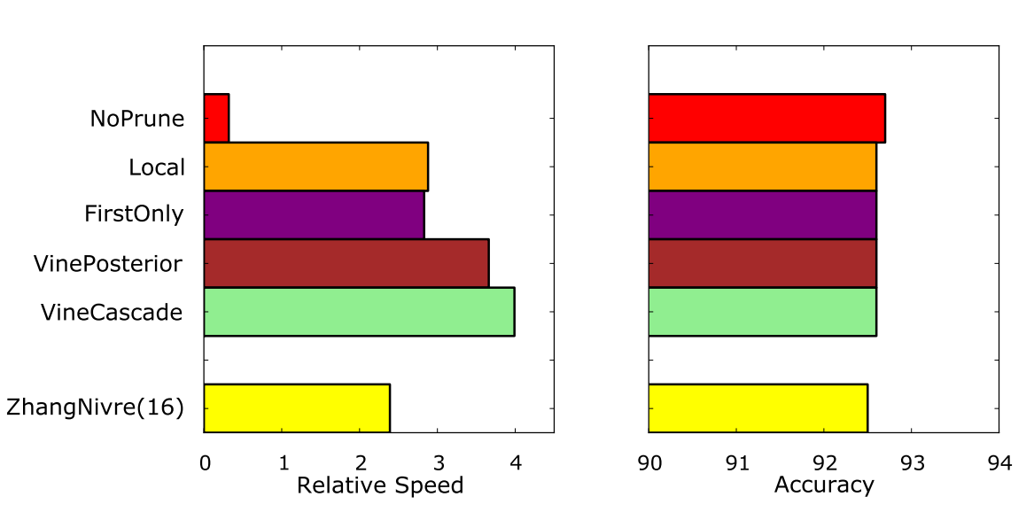
Results and Comparison
Second order without pruning
Only first order pruning
Only vine pruning
Vine cascade
Malt parser
Notes:
And the author also compares the results with other traditional algorithms. We can see the vine cascade algorithm is the fastest, even faster than a greedy parser Malt. What’s more, vine cascade parsing has no obvious loss in accuracy.

Slide 30
Thank you!
? / .
Notes:
That’s all. Thank you. Any questions?

